Slide 1
AI Chess Opponent
Karim Zaher

Slide 2
Parts Used
Libraries Used
Chess board
WS2812B LED Strip
Pi Camera
Button
Buzzer
OpenCV
GPIOZero
Pygame

Slide 3
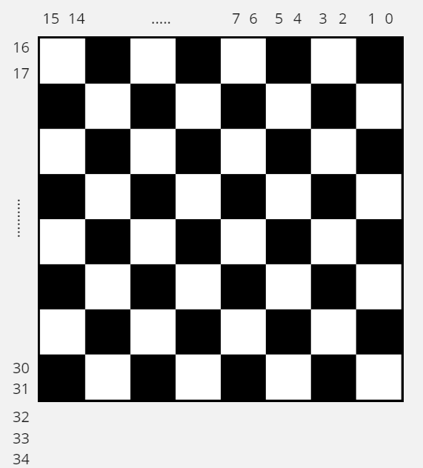
WS2812B LED Strip
The AI opponent’s plays are conveyed through the LEDs, where red LEDs indicate the piece’s initial location and green LEDs indicate where the piece should be moved.
Equations used to calculate the LEDs index:
redX = 15 - currentPos_x * 2
redY = 16 + currentPos_y * 2
greenX = 14 - newPos_x * 2
greenY = 17 + newPos_y * 2
Feedback LEDs: LEDs 32, 33, and 34 are used to convey instructions
32, 33, and 34 = Clear board then press button
32 only = Place pieces on board then press button
33 only = Move user’s piece to new position then press button
34 only = Move AI opponent’s piece to new location

Slide 4
Image Processing
Picture of empty chess board is taken
Image is flipped so that image traversal is faster [spend less time travelling through extra space]
Image converted to binary to remove any background or lighting noise
Edge of each grid is detected using Canny edge detection
Edges that Canny edge detection failed to find is estimated using Hough Line Transform and marks all edges with a thick, red line

Slide 5
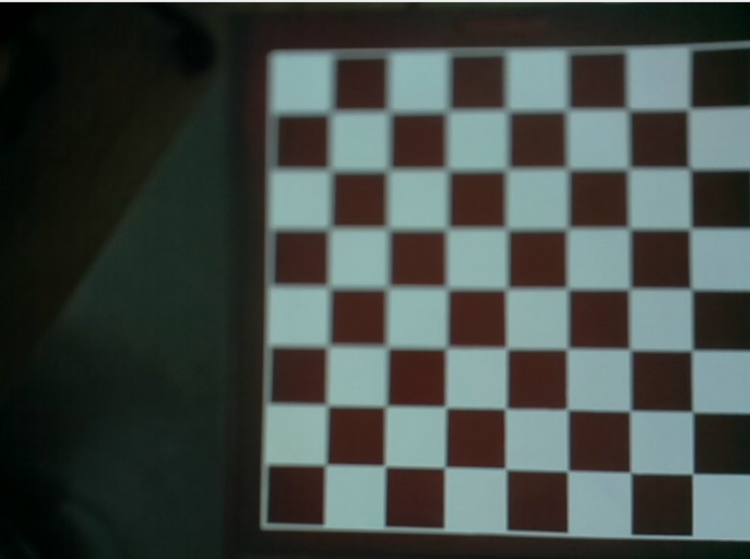
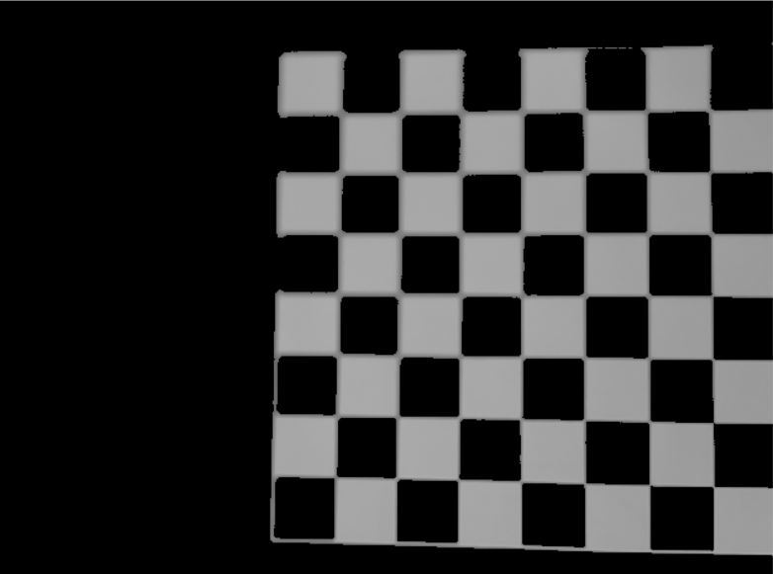
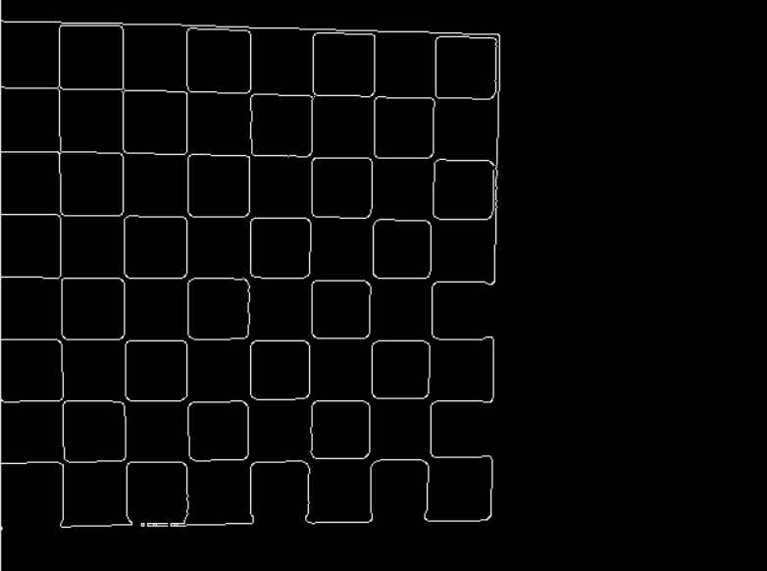
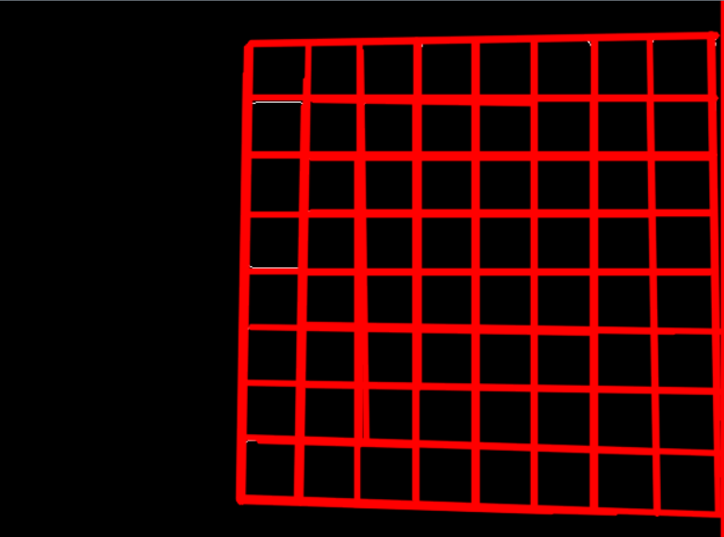
Image Processing Visual
Initial Image
Flipped Image
Binary Image
Canny Image
The Hough Line Transform image is used to find the
x and y coordinate ranges that encompass each
individual grid.
Hough Line Transform Image

Slide 6
Movement Detection
Movements are detected by changes in chess board (obviously)
Done by comparing image before player’s turn to image after player’s turn
For player:
Find the two grids with the largest percent change in individual pixels. Those two positions will always represent the player’s old and new position
For AI:
Watch AI’s new grid position. If percent change of the grid is not higher than 20%, flash red lights and prompt the player to make sure they did not misplace the piece

Slide 7
AI’s Brain -- Minimax Algorithm
This algorithm uses a tree to look at every possible scenario within a certain number of rounds which depends on the set depth of the tree.
Each node on the tree is then assigned a value based on what pieces could potentially get lost during that round.
Assuming depth = 1 for visual simplicity
Depth used in project = 80
1000
100
1200
All possible moves and their weight

Slide 8
Minimax Weights
Pawn = 10
Not the most important piece in the game.
Knight = 30
Slightly more important than the pawn.
Bishop = 30
Slightly more important than the pawn.
Rook = 50
I gave this a higher score because I personally use rooks to checkmate my opponents whenever I play.
Queen = 650
The queen is definitely the most important piece in the game, however, if she could be sacrificed for a good play, then it is worth losing her.
King = 900
The king cannot be lost in any case. Losing the king means losing the game, which is not what the AI is supposed to do. Therefore, it should avoid situations in which the king is at most risk.

Slide 9
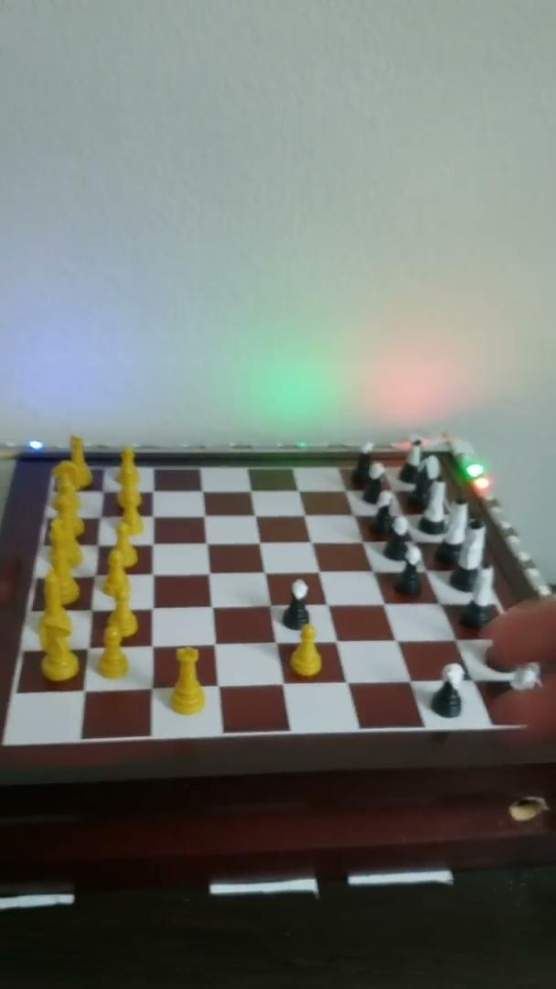
Demo Video

